Slide 1
ACG final project (openGL) W11 Crash
Muhammad Shoaib Khan B-09101038

Slide 2
Environment modeling
The environment modeled for this project is the location of Karachi.
SMCHS, karachi pakistan

Slide 3
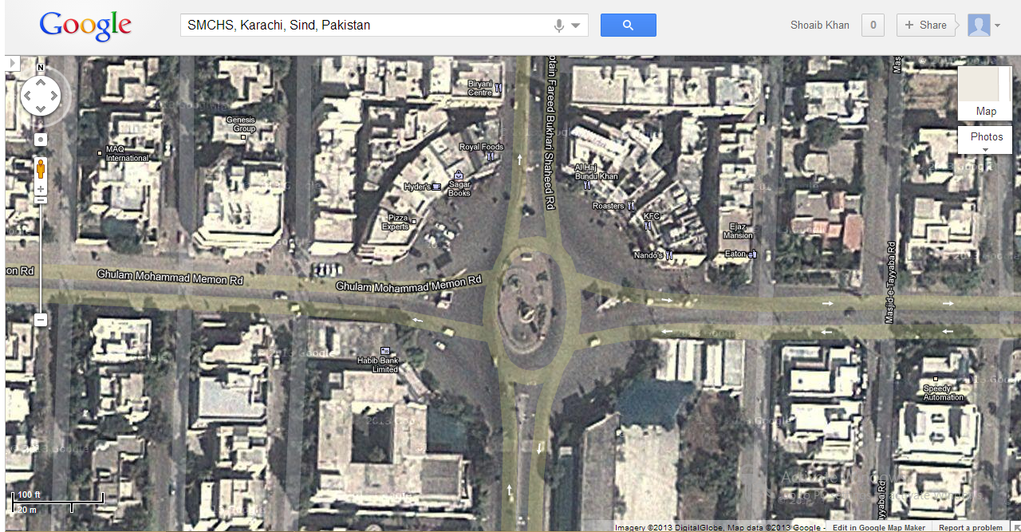

Slide 4
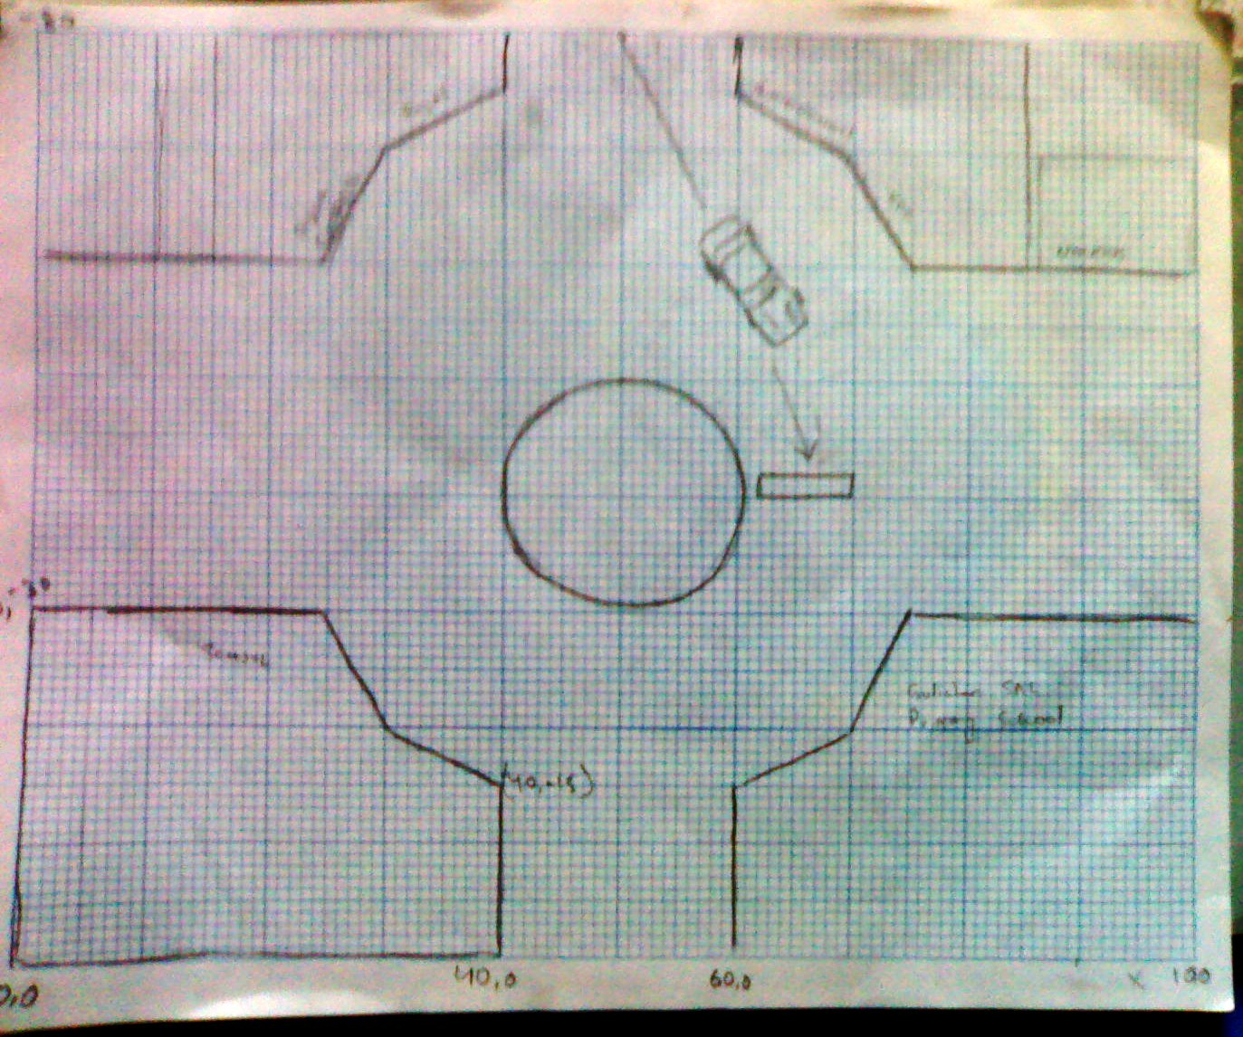

Slide 5
Extrusion
Four of the buildings are modeled by extrusion technique.
Points of the base polygon along with required height is provided.
Point2 kfcpoints[] = {Point2(60,75),Point2(60,80),Point2(70,70),Point2(70,80),Point2(75,60),Point2(75,80),Point2(85,60),Point2(85,80),Point2(100,60),Point2(100,70)};
kfc.extrudedPolygon(kfcpoints,10,12);

Slide 6
Roundabout
The roundabout is modeled using parametric equation of cylinder.
cylinderOneStack(15,1,0,360,0,180);

Slide 7
Bus
Bus is modeled by using case study : Modeling Smooth Surfaces with 4 slices and 10 stacks.
The reason behind not using a scaled cube is that we have to apply deformation on it.
Therefore different points are required on its surface.

Slide 8
Rest of the Buildings
Rest of the buildings are scaled cubes.

Slide 9
Texturing & Lightning
Every modeled object is textured.
We used different techniques to texture objects.
We wrapped the texture on on whole surface as well as texture on individual face is also done.
Lightning is used.

Slide 10
Animations
There are some animations that are handled in this project.
Camera animation
Bus movement
Deformation
Wall breaking

Slide 11
Deformation
Deformation is done by transforming the default points of the bus to new location under some function.
I used sine function.
if(i%2 == 0){
bus.pt[i].x =bus.pt[i].x * sin(deformX);
Where deformX is a counter

Slide 12
Wall Break Animation/Physics
The wall consists of 18 blocks with 6 blocks in one row.
Every block is assigned with their initial velocities and they follows the path which is obtained by
Dx = Vi * t
Dy = Vit *0.5gt^2

Slide 13
review
The overall project covers:
Modeling: extruded surface
Modeling: smooth surfaces using parametric equations
Animation(bus/camera movement, deformation, wall breaking)
Texturing
Lightning
Camera movement
Transformations(Rotation(euler), Translation,scale)
Deformation
Physics
skybox

